Slide 1
Real-Time Social Media Analysis Esha Mazhar 2022-BSSE-073 Yousma Khayyam 2022-BSSE-123 Iqra Fatima 2022-BSSE-127 Hafsa Ijaz 2022-BSSE-137

Slide 2

INTRODUCTION
What is Real-Time Social Media Analysis?
The process of monitoring and analyzing social media platforms as data is generated.
Captures trends, sentiment, and user interactions in real time.
Why is it Important?
Timely insights for decision-making.
Enhances customer engagement, brand monitoring, and crisis management.

Slide 3
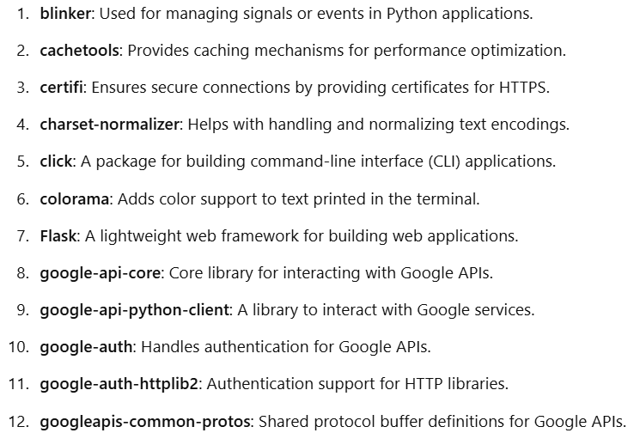
LIBRARIES USED

Slide 4
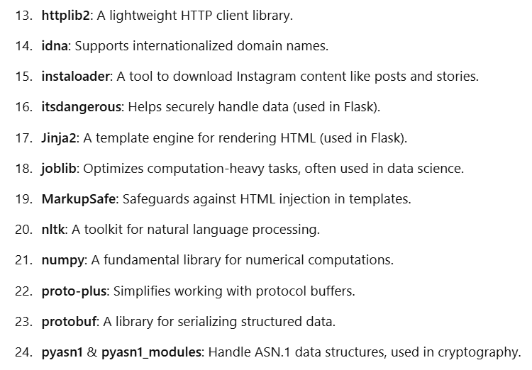
LIBRARIES USED

Slide 5
ALGORITHM USED
Logistic Regression:
Logistic Regression is a machine learning algorithm used for classification tasks, predicting the probability of a target class (e.g., positive vs. negative sentiment).
Key Features:
Binary or Multi-Class Classification: Assigns inputs to categories like spam vs. non-spam or positive vs. negative.
Sigmoid Function: Converts linear outputs into probabilities
Applications in Social Media Analysis:
Sentiment analysis (positive/negative).
Spam detection.
Topic classification.
Advantages:
Easy to interpret and implement.
Works well for simple classification problems.

Slide 6
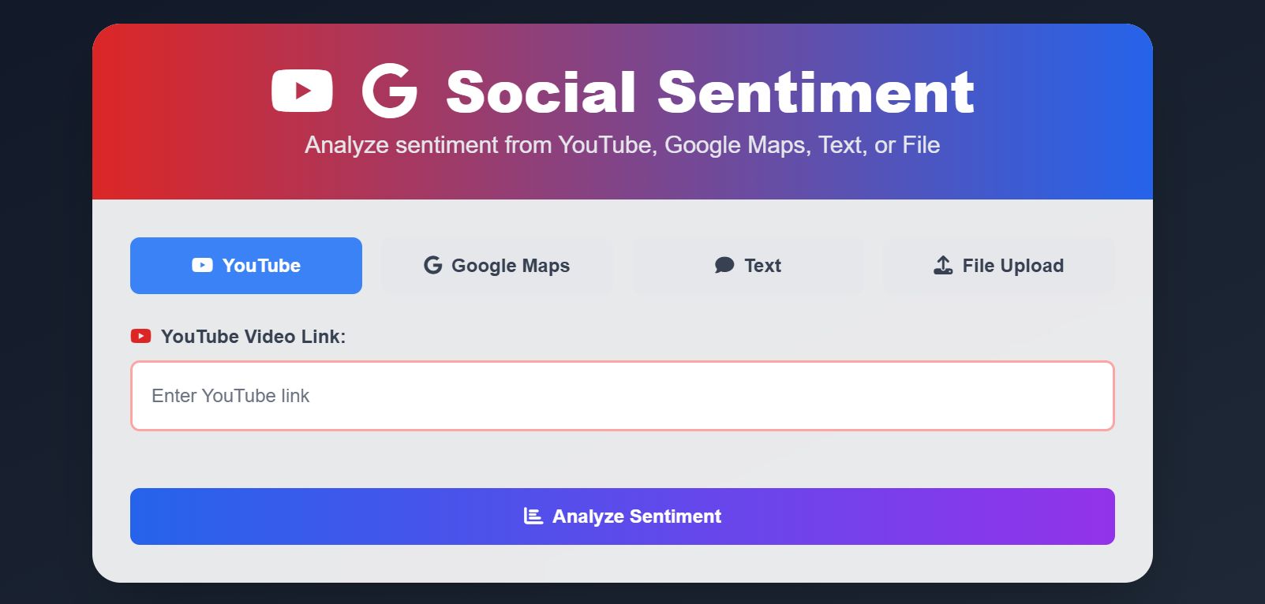
GUI

Slide 7
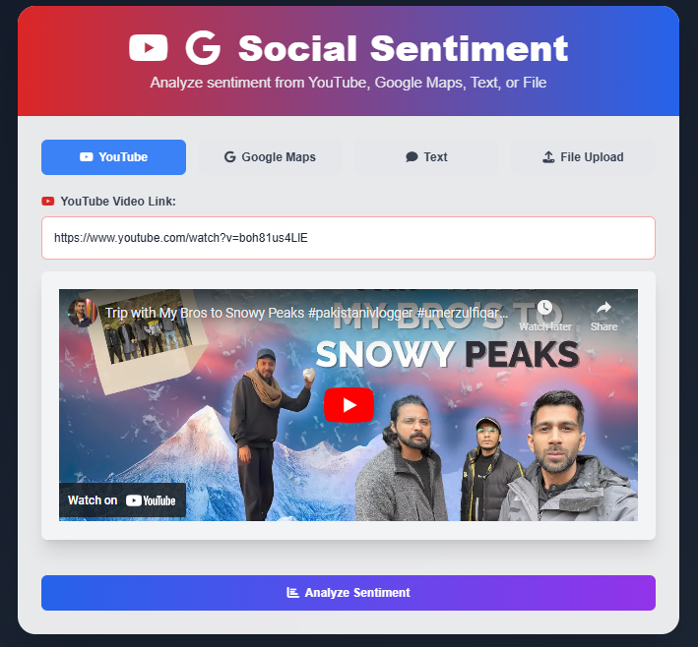
YOUTUBE ANALYSIS

Slide 8
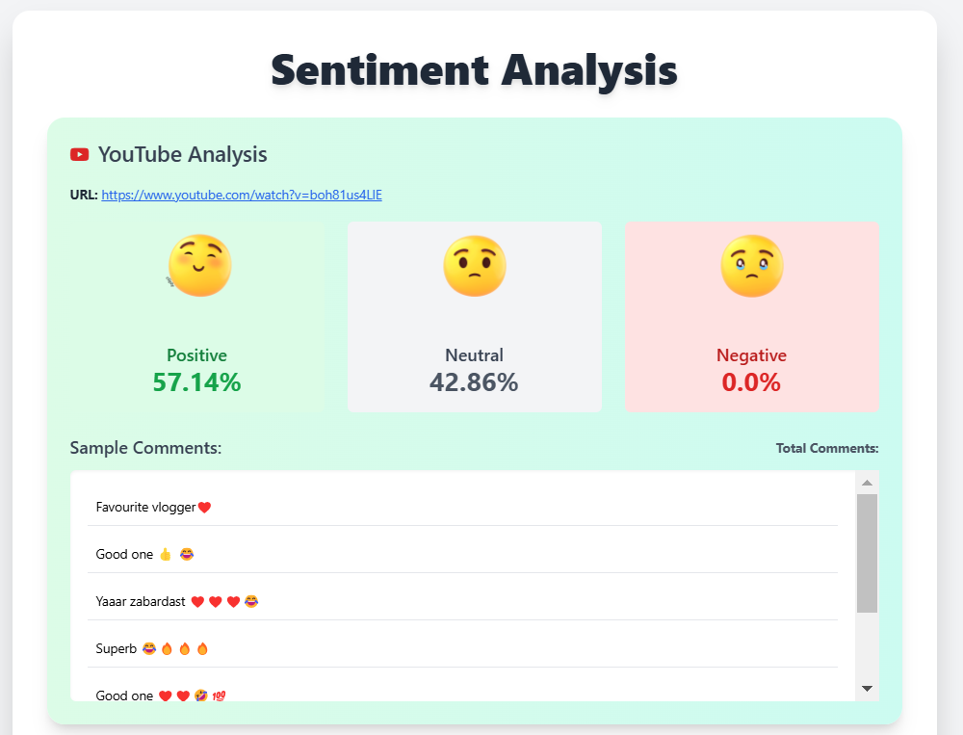
YOUTUBE ANALYSIS

Slide 9
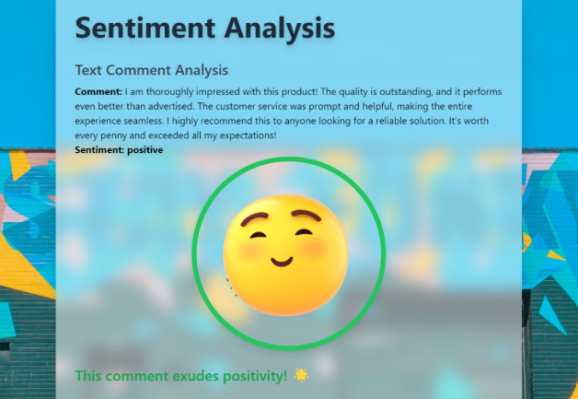
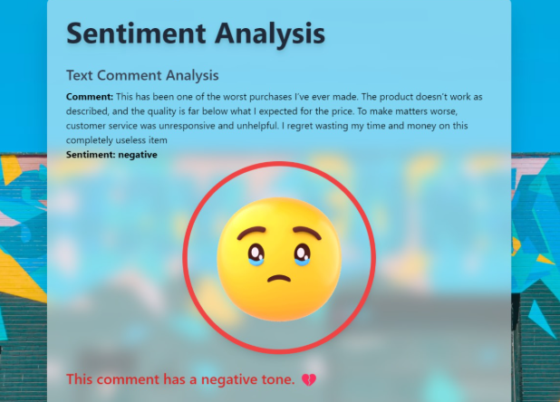
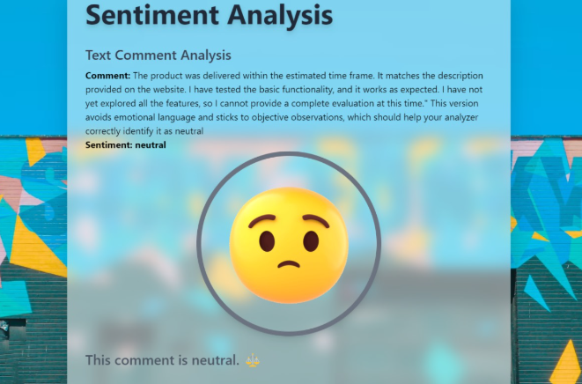
TEXT ANALYSIS

Slide 10
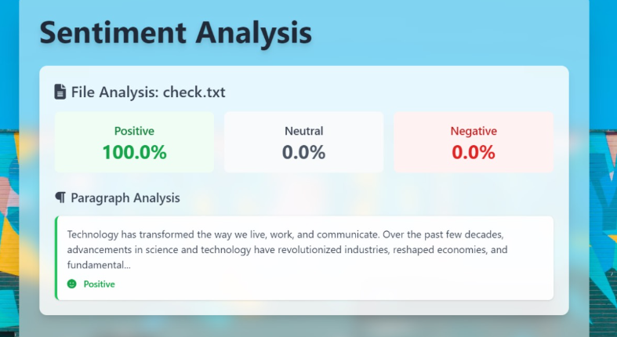
FILE ANALYSIS

Slide 11
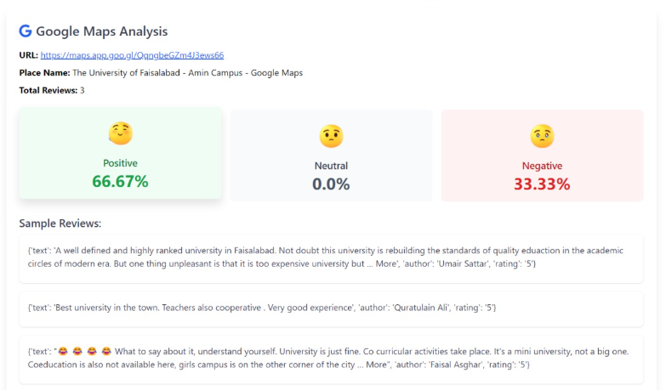
GOOGLE MAP REVIEW ANALYSIS

Slide 12
Project analysis slide 3
How It Works
Data Collection
Preprocessing
Analysis
Visualization
Action
Using APIs to stream posts, tweets, comments, etc..
Cleaning, filtering, and structuring data.
Sentiment analysis, trend detection, and influence mapping.
Presenting insights in dashboards and reports.
Informing strategy and responding to event.

Slide 13
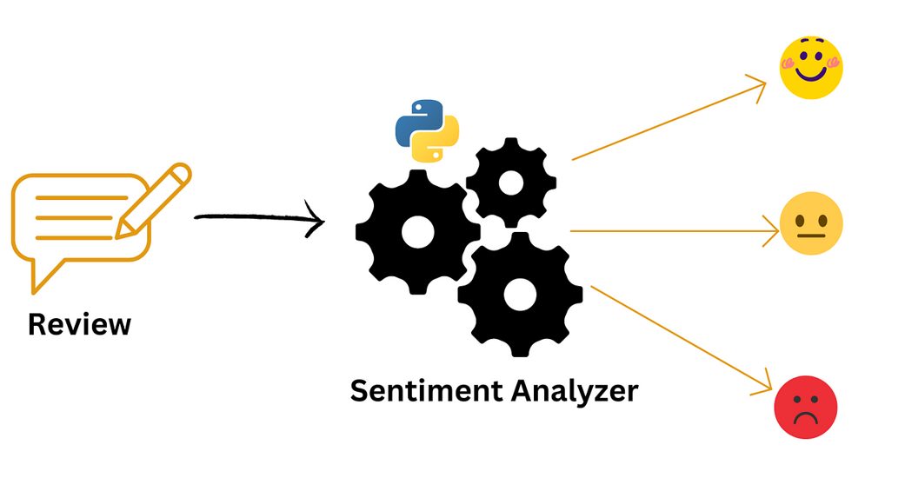
REAL-LIFE USE CASES
1. Brand Monitoring:
Example: Tracking customer feedback on a new product launch.
2. Crisis Management:
Example: Airlines responding to delays or cancellations.
3. Political Campaigns:
Example: Analyzing voter sentiment during debates.
4. Event Monitoring:
Example: Real-time feedback during live events.

Slide 14
Project analysis slide 2
PROS
Timely Insights
Enhanced Engagement
PROs
Crisis Management
Competitive Edge
Optimized Marketing

Slide 15
Project analysis slide 8
CONS
Data Volume
Noise
Handling the sheer amount of data generated.
Filtering irrelevant or low-quality content.
Latency
Privacy Concerns
Ensuring minimal delay in analysis and response
Adhering to ethical and legal standards..

Slide 16

CONCLUSION
Key Takeaways:
Real-time social media analysis empowers organizations to stay informed and responsive.
The combination of data, AI, and visualization tools unlocks actionable insights.
Future Outlook:
Growing importance in diverse sectors like marketing, politics, and customer service.

Slide 17
Thank You

